Slide 1
Powered Exoskeleton
By- Andres Montano and Emily Hernandez

Slide 2
Overview
History 1
History 2
Visual representation
Implementation
Pros
Cons
Summary
References

Slide 3
History (Build-Up)
How it started:
1965- US development for hardiman , Exoskeleton to help users strength
First exoskeletons developed end of 1960s at Mihajlo Pupin Institute Serbia
First in the US in the 1970s at Wisconsin-Madison University
Notes:
The development of robotic exoskeletons already began in the second half of the 20th century. Around 1965, General Electric (in the US) started to develop the Hardiman, a large full-body exoskeleton designed to augment the user’s strength to enable the lifting of heavy objects. The first exoskeletons for gait assistance were developed at the end of the 1960s at the Mihajlo Pupin Institute Serbia, and in the early 1970s at the University of Wisconsin-Madison in the US

Slide 4
History (Modern Day)
Beginning of the 21st century, exoskeletons made their way into the market
First uses were in hospitals for rehabilitation
Development continues and scientists and tech companies are looking for more ways to use exoskeletons.
Notes:
With the beginning of the 21st century, the first exoskeleton products made their way to the market and are accessible to an increasing number of users. One of the first applications was gait rehabilitation in stroke and spinal cord injured patients. An early example is the gait rehabilitation exoskeleton Lokomat that was released in 2001 and is used in hospitals and rehabilitation centers worldwide. In 2013, the company behind the Lokomat (Hocoma AG) announced the shipment of the 500th device.

Slide 5
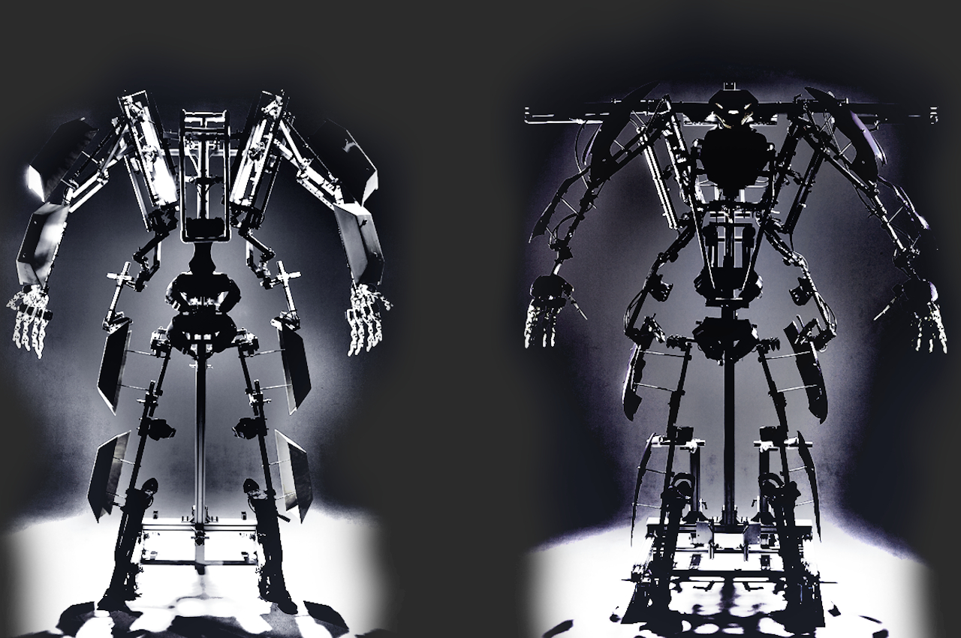
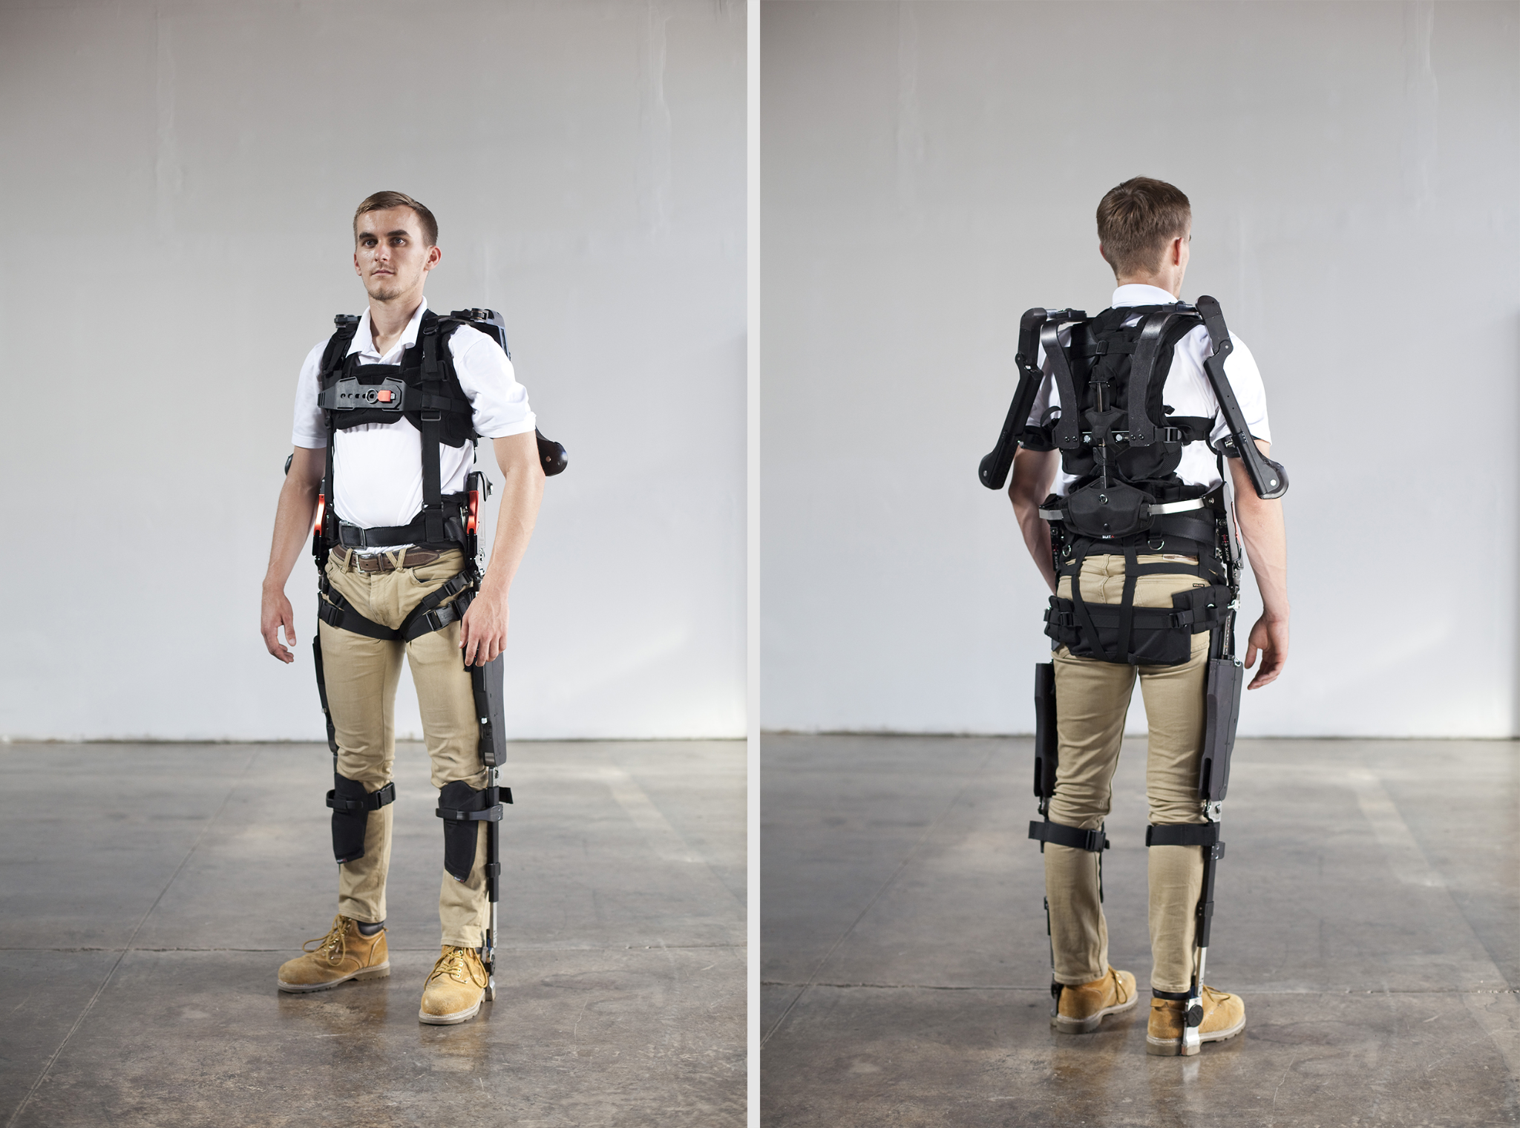
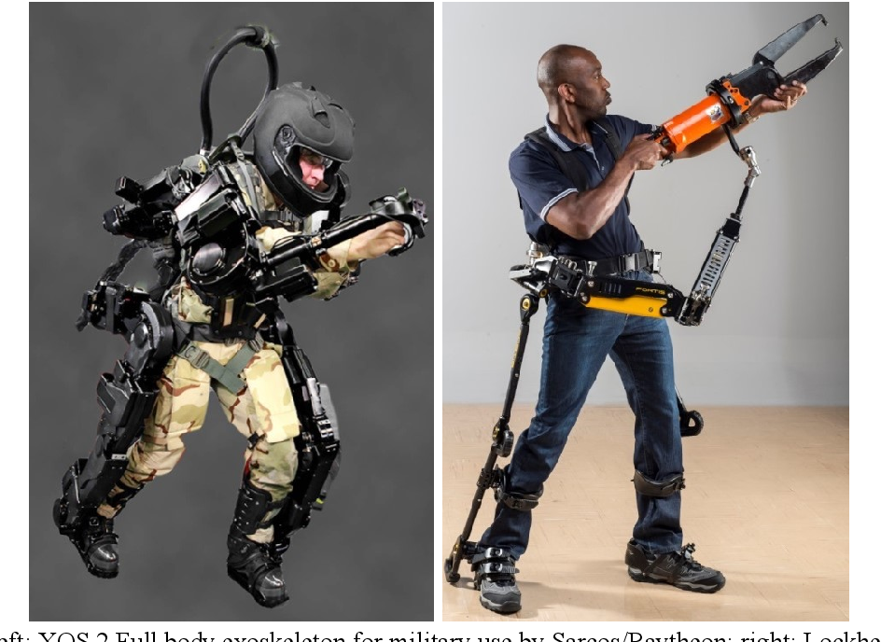
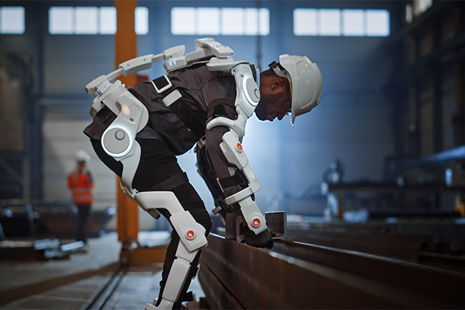
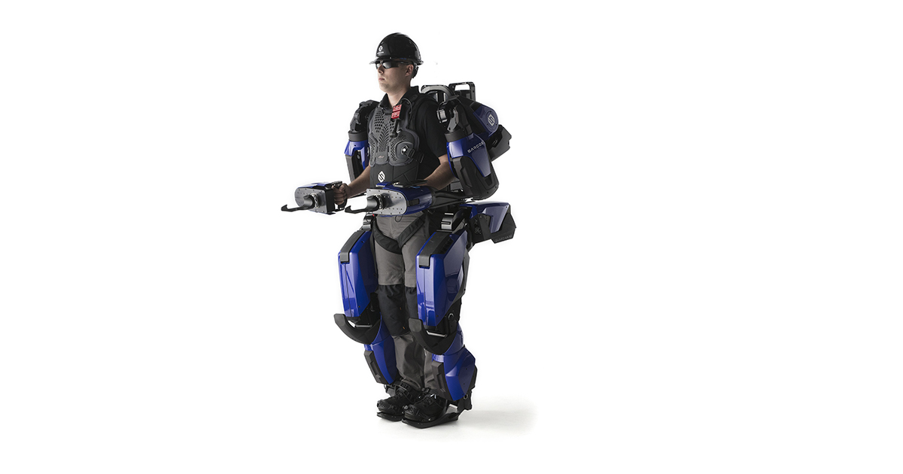
What it would look like:

Slide 6
implementation
MIlitary
Rehabilitation
Construction
disabilities/medical
Notes:
slightly less incredible version of Iron Man's suit may enable U.S. soldiers to run faster, carry heavier weapons and leap over obstacles on the battlefield. And at the same time, it'll shield them from the effects of bullets and bombs. defense contractor Raytheon demonstrated the experimental XOS 2 -- essentially, a wearable robot guided by the human brain -- that can lift two to three times as much weight as an unassisted human, with no effort required by the user. It's possible that someday people with spinal injuries or muscle-wasting diseases may get around as easily as fully-abled people do, thanks to full-body devices -- essentially, wearable robots -- that enable them to do what their own muscles and nerves can't. They can provide support and reduce fatigue. They even enable people in wheelchairs to stand up and walk again.

Slide 7
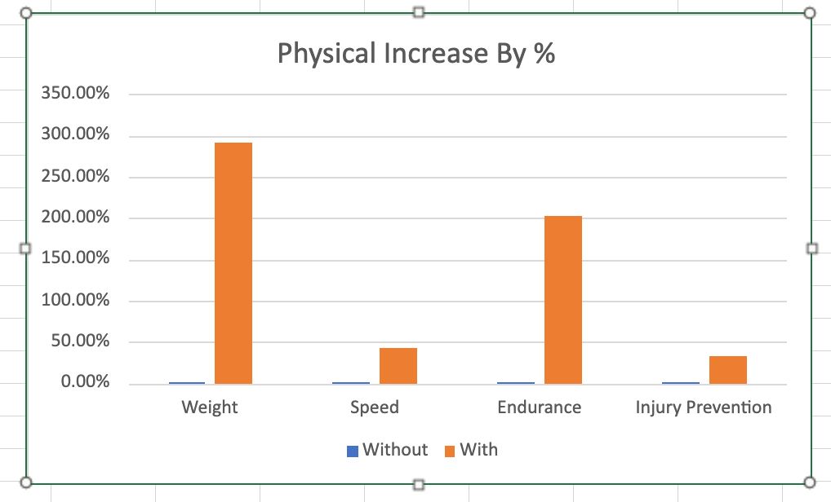
Graph
This graph shows baseline physical capabilities of individuals starting at baseline (without and without) the exoskeleton suit
Notes:
51-200- Weight
0%-42%- speed
3.2 min- 9.7 min- endurance
0%-10% to 44%- injury prevention

Slide 8

pros
Improves strength
Improves endurance
Improves productivity
Decreases risk of injury
Allows more complex movement
Notes:
Workers using exoskeletons experience less fatigue, with the ability to complete more work than their bodies could typically handle due to the decreased strain on various body parts. Studies show that exoskeletons increase productivity from two to 27 times, depending on the task at hand, allowing operators to work 30 minutes or longer without requiring rest breaks. One of the main goals of robotic exoskeletons is to combat fatigue in the workplace. In 2019, the most common cause for workplace injuries was extreme fatigue and overexertion, with 20 percent of construction workers reporting severe pain. In fact, construction workers are 5x more likely to report poor health. Providing postural support that can follow the movements of the arms without misalignment or resistance can generate a 30 percent reduction in stress on the shoulder muscles. Perceived discomfort measures how hard a person feels he or she is working, used to measure the physical activity intensity level. Exoskeletons have been shown to reduce perceived discomfort in all body areas, including forearms, neck, shoulders, upper arm, upper back, legs and lower back.

Slide 9
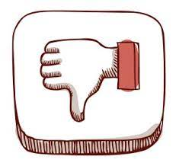
Cons
Bulky and heavy
Pressure injuries
Price
Notes:
Heavy and Bulky Exoskeletons tend to be bulky and some can be heavy. Although it helps a worker improve performance, it can be disadvantageous due to its weight. Speed Exoskeletons offer a range of varying speeds and most are characterized by a modest speed that is slightly greater than 0.2 m/sec, which may impede their general use. Handgrip Many spinal cord injury patients may not be able to use an exoskeleton due to the lack of appropriate hand grip. Pressure Injuries Around 70%-75% of persons with spinal cord injury experience pressure injuries during their lifetime with dramatic changes in their skin structures that are likely to break down with a minimal amount of shear. Powered exoskeletons are likely to have straps to help to maintain static and dynamic posture during standing and walking. With diminished sensation and impaired peripheral circulation, these straps are likely to cause excessive shear to the surrounding soft tissues and may lead to pressure injuries. Price The biggest drawback of exoskeletons is their prices. An exoskeleton can cost around $45,000, and that is why many people cannot afford them.

Slide 10
summary
Overall this rising technology would be beneficial for certain industries like construction where physical labor could be intense and long. It could also be very beneficial in the anything physicality is needed like the military and can even help those with medical conditions and those who are recovering from injuries. This is a trusting technology and at the moment closest thing humans can get to super strength and sci-fi robot suits.

Slide 11
references
A Brief History of Robotic Exoskeletons EDUXO
HOW DO EXOSKELETONS WORK? Levitate Technologies Inc.
How Exoskeletons Will Work How Things Work
Robotic exoskeletons: The current pros and cons NIH
5 Advantages Of Using Robotic Exoskeletons Ekso Bionics
Advantages and Disadvantages of Exoskeletons Wearable Technologies

